Slide 1
CORONARY ARTERY ANOMALIES
By
Dr Balamurugan T
Dept of cardiology
Cailcut medical college

Slide 2
OVERVIEW
Basic Embryology
Incidence and classification.
Anomalies of origin and course.
Anomalies of intrinsic coronary anatomy
Anomalies of termination
Coronary anomalies associated with CHD

Slide 3
INTRODUCTION
Coronary artery anomalies (CAAs) are a diverse group of congenital disorders whose manifestations and pathophysiological mechanisms are highly variable.
The subject of CAAs is undergoing profound evolutionary changes related to the definition, morphogenesis, clinical presentation, diagnostic workup, prognosis, and treatment of these anomalies.
CAAs that has the most potential for clinical manifestations, specifically sudden cardiac death in the young.

Slide 4
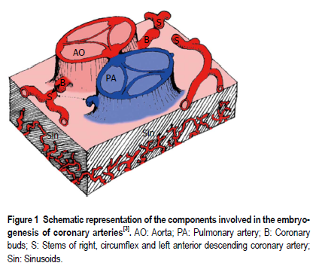
Coronary Arteries- Development
There are three basic elements for development of the coronary vasculature:
(1) the sinusoids;
(2) the in situ vascular endothelial network; and
(3) the coronary buds on the aortic sinuses .

Slide 5
Theories
Outgrowth development hypothesis: fusion of subepicardial vascular network with endothelial buds that grew from the base of the truncus arteriosus.
1989, Bogers identified coronary arteries in aortic wall prior to emergence of coronary ostia -suggests ingrowth rather than outgrowth of these vessels.

Slide 6
It is now understood that coronary arteries develop within the epicardial atrioventricular and interventricular grooves and that their proximal parts grow into the aortic valve sinuses.
The LCA arises from the left posterior quadrant of the proximal bulbus cordis, while the RCA arises from the right side.
The major coronary arteries reach their aortic connections subsequently to the aorto-pulmonary rotation, so the location of the aortic root relative to the cardiac base is responsible for the matching between the coronary arteries and their sinuses of origin.

Slide 7
Strict relationship between the distribution and size of the major epicardial coronary arteries and the extent of their dependent myocardium.
A lack of coronary blood flow during development - Hypoplasia of the dependent myocardial mass.
The sinusoidal network gradually regresses, Persistence of the sinusoids results in coronary fistulae
Abnormalities in the development of the coronary buds or the endothelial network are responsible for CAAs.

Slide 8
Basic principle of coronary classification Name of a coronary artery assigned not according to the site of origin or proximal course But according to the dependent territory.
A common proximal trunk, which joins 2 or 3 coronary arteries is named a mixed trunk. RCA is the vessel that crosses the right AV groove and provides blood flow to the right ventricular free wall. LAD is the vessel that courses the anterior IV groove and provides blood flow to the anterior interventricular septum. LCX is the vessel that courses the left AV groove and provides blood flow to the free wall of the left ventricle, on the obtuse margin of the heart.

Slide 9
DEFINITIONS
Defining what anatomy of the coronary arteries is normal - challenging.
Normal features can be defined in numerical terms (for example, the number of coronary ostia), while in some other cases a more qualitative description is required.
Angelini and coworkers proposed to classify “normal” as every feature with > 1% of frequency in an unselected general population

Slide 10
Normal coronary anatomy, defined as any morphological characteristics seen in > 1% of unselected sample. This group also includes normal anatomical variants, defined as alternative and relatively unusual morphological feature observed in > 1% of the population; and
Anomalous coronary anatomy, defined as morphological features found in < 1% of the population

Slide 11
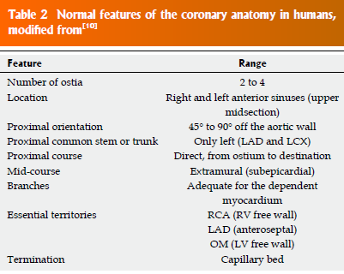
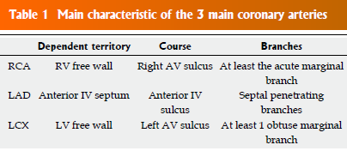
NORMAL CORONARY

Slide 12
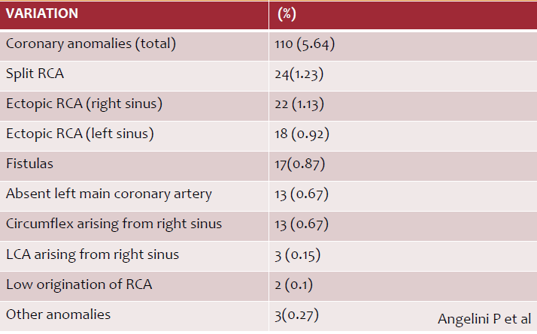
INCIDENCE

Slide 13
IMPORTANCE
Difficulty during cannulation
Needs to know before going to any thoracic surgery
Some anomaly can cause ischemia and prone for atherosclerosis
More importantly some can cause SCD

Slide 14
IMAGING
TTE & TEE
CAG
CORONARY CT ANGIO
CARDIAC MRI
Notes:
the reported incidence of AOCA on TTE was 0.17%, significantly lower compared with 1.07% incidence found at coronary angiography

Slide 15
CLASSIFICATIONS
A) Anomalies of origination and course
B) Anomalies of intrinsic coronary arterial anatomy
C) Anomalies of coronary termination
D) Anomalous collateral vessels

Slide 16
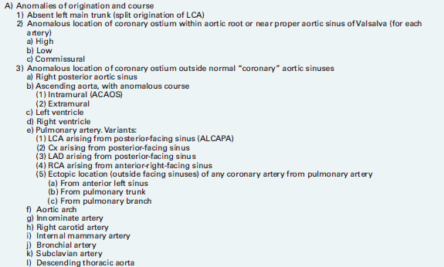

Slide 17
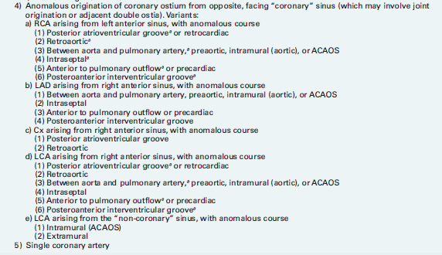
Notes:
'If a single , common ostium is present, the pattern is considered to represent " s i n g l e " c o ro n a r y a r t e r y.

Slide 18
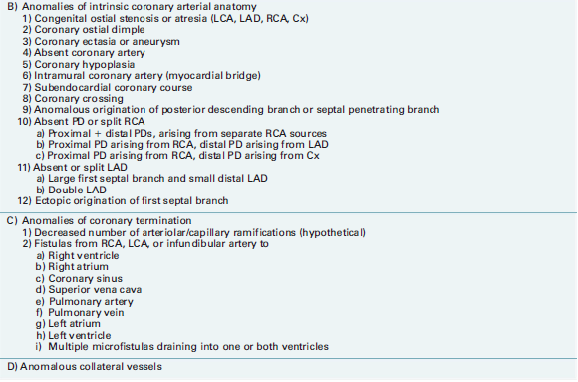
Angelini. Coronary Artery Anomalies. Circulation March 13, 2007

Slide 19
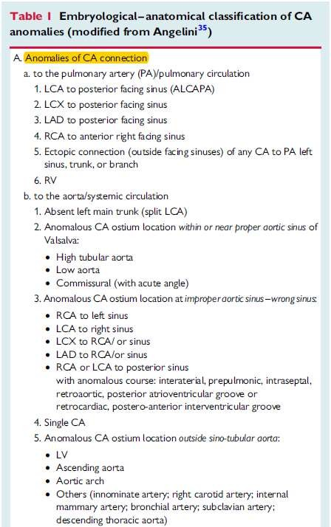

Slide 20
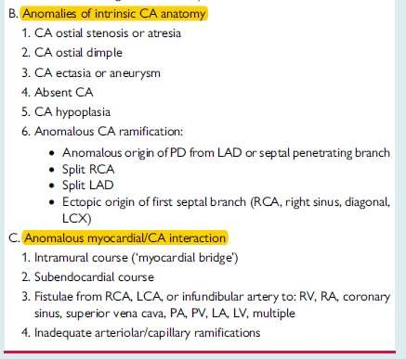
J.M. Pe´rez-Pomares et al. Congenital coronary artery anomalies (2016) 109, 204–216

Slide 21
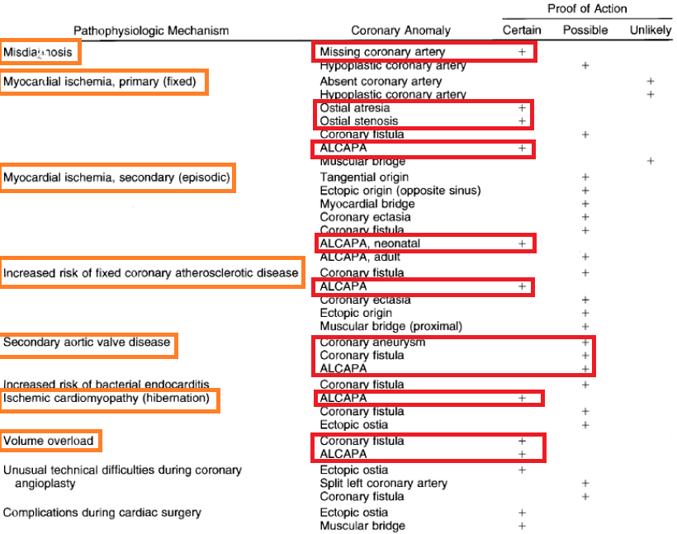
FUNCTIONAL CLASSIFICATION

Slide 22
Anomalies classified as hemodynamically significant include:
  anomalies of origination with interarterial course
  anomalous origin in the pulmonary artery;
  atresias;
  congenital fistulas
Villa ADM et al . Coronary artery anomalies. June 28, 2016|Volume 8|Issue 6|

Slide 23
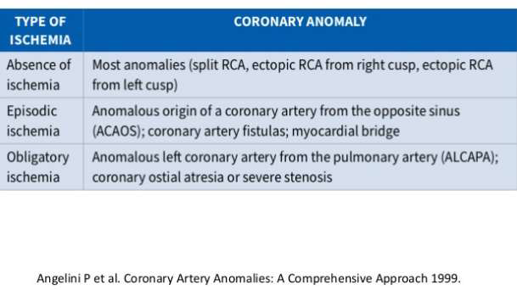
Classification based on ischemia

Slide 24
Anomalies of origination and course
Absent left main trunk (split origination of LCA)
LAD and Cx originates from LCS without common trunk
Occurs in about 1%
More frequent with BAV, left dominance
No clinical consequences
Coronary ostia are smaller
J.M. Pe´rez-Pomares et al. Congenital coronary artery anomalies (2016) 109, 204–216

Slide 25
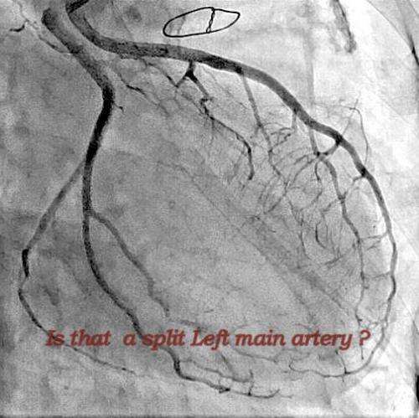

Slide 26
CANNULATION
Inject more dye so that LCX also can be visualized
If LAD is cannulated it is pulled back into aorta and clockwise torque is given to cannulate LCX
Use JL4 for LAD and longer curve for LCX
JL catheter for selective cannulation of LAD and amplatz left catheter for LCX

Slide 27
Anomalous location of coronary ostium within aortic root or near proper aortic sinus of Valsalva
a. High
b. Low
c. Commissural
It is defined as origin of a coronary artery or left coronary trunk more than 1 cm above the sinotubular junction.
Caution during ascending aorta surgery and may cause difficulties in catheterization during angiography.
Most frequently – In RCA, sometimes associated with bicuspid aortic valve

Slide 28
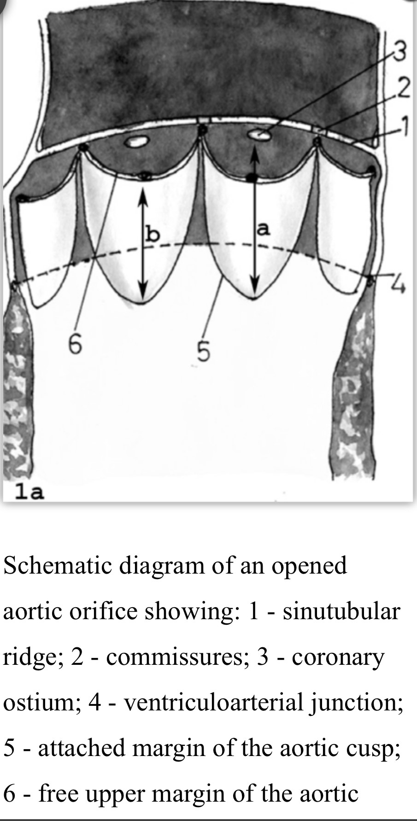
CANNULATION
High origin of LCA engaged with Amplatz left, MP catheter
High origin of RCA engaged with Amplatz catheter

Slide 29
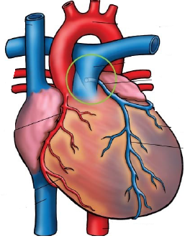
ALCAPA
LCA arises from PA usually from left posterior facing sinus
Fetus-both coronary arteries receive forward flow
Early after birth - Anterolateral infarct and slight retrograde flow from LCA to PA
15% of patients-myocardial blood flow can sustain myocardial function at rest or even during exercise
Adult-Enlarged RCA and collaterals and significant retrograde flow into PA
Notes:
Less commonly originates from other pulmonary sinuses or more distally in main or proximal branch pulmonary arteries.

Slide 30
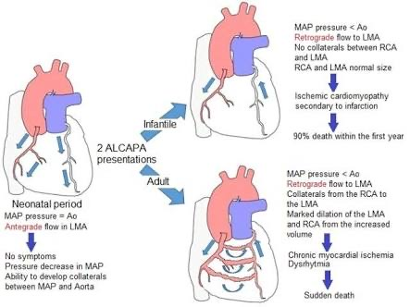

Slide 32
Chest X ray:
Non specific
Cardiomegaly LV enlargement
Pulmonary venous congestion
ECG:
Pathological q waves lateral leads
Poor R wave progression and T wave inversion.
Q wave width > 30 ms in lead I, q wave depth >3 mm in aVL and QR pattern in aVL significantly associated with ALCAPA.

Slide 33
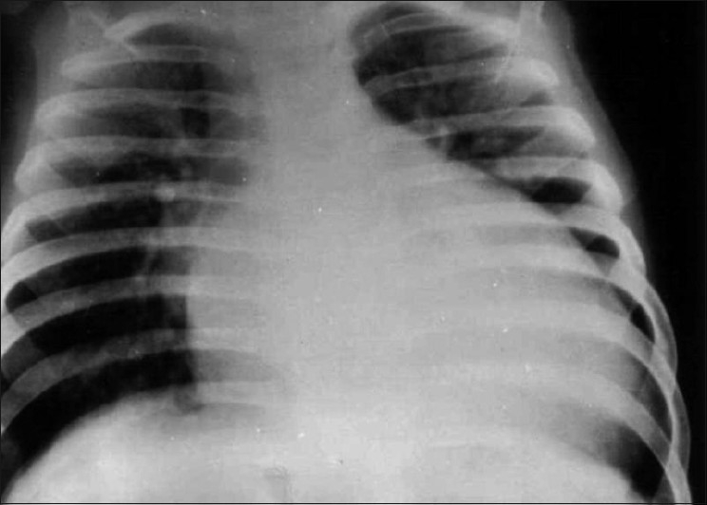

Slide 34
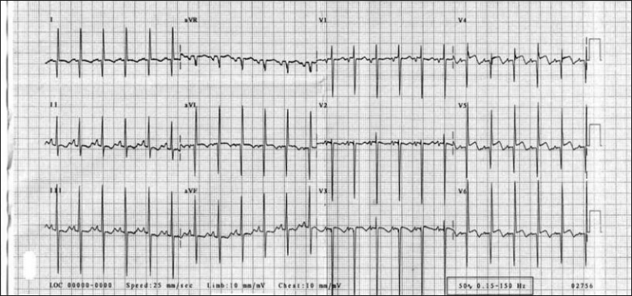

Slide 35

ECHO:
LV dilated, Impaired systolic and diastolic function
Papillary muscles bright and echogenic ( due to infarction and fibrosis), Mitral regurgitation.
2D imaging of coronaries: LCA takes a course very close to left aortic sinus (connection may be misinterpretated as normal in upto 70%).
Doppler assessment with colour flow mapping of coronary flow
    Retrograde flow in LAD and retrograde jet of flow in PA
RCA dilated – RCA: aorta ratio ≥0.14.

Slide 36
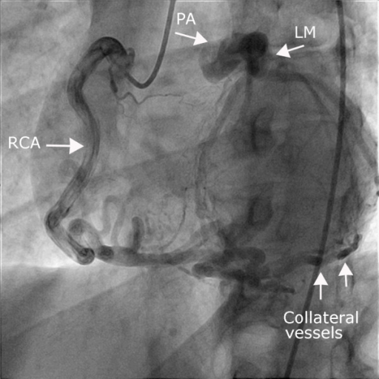
CT/ MRI: useful in adult patients with poor acoustic window.
CT demonstrates better spatial resolution.
MRI allows functional assessment of LV function and myocardial viability.
Cardiac Catheterisation:
Gold standard for diagnosis.
Elevated LVEDP, Low CO, subsequently elevated pulmonary and RV pressures.
Aortic root angiography or selective RCA :-Dilated RCA
Large collaterals-filling of LCA and passage of contrast material to MPA

Slide 37
Management
Medical supportive treatment: ventilation, inotropes, diuretics and afterload reduction.
Surgical techniques:

Slide 38
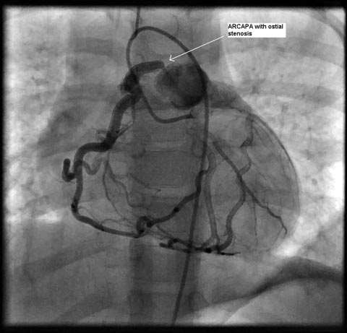
ARCAPA
Rarer than ALCAPA.
Diagnosis is usually made at autopsy or incidentally in asymptomatic adults.
Less commonly present with myocardial ischemia and SCD, particularly in right dominant coronary pattern.
Treatment : surgical Reimplantation.
  With evidence of ischemia.

Slide 39
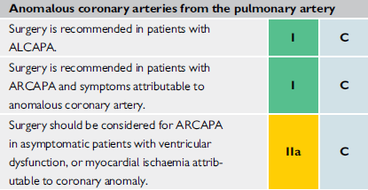
ESC 2020

Slide 40
Isolated connection of LCX or LAD from pulmonary trunk:
Less lethal than ALCAPA.
Rarer than ARCAPA.
Indication for surgery similar to ARCAPA.
Total Anomalous Connection of Coronary Arteries to Pulmonary Trunk:
Single ostium and trunk from which all branches emerge or from 2 ostia close together giving rise to left and right coronary systems.
Symptoms appear within a few days of birth, and death follows within 2 weeks.

Slide 41
ACAOS

Slide 42
Serious prognostic implications in young individuals.
Incidence
Among, 9,907 patients who underwent electron-beam CT or 64-detector MDCT, incidence of ACAOS was 0.7%.
Prevalence RCA from left sinus 56%, LCX from right sinus 16.7%, LM from right sinus 8.3%, LAD from right sinus 2.4%.
Nezarat N, Luo Y, Darabian S, et al. PREVALENCE AND LONG TERM FOLLOW-UP OF ANOMALOUS CORONARY ARTERIES ORIGINATING FROM OPPOSITE SINUS (ACAOS). J Am Coll Cardiol. 2015;65.

Slide 43
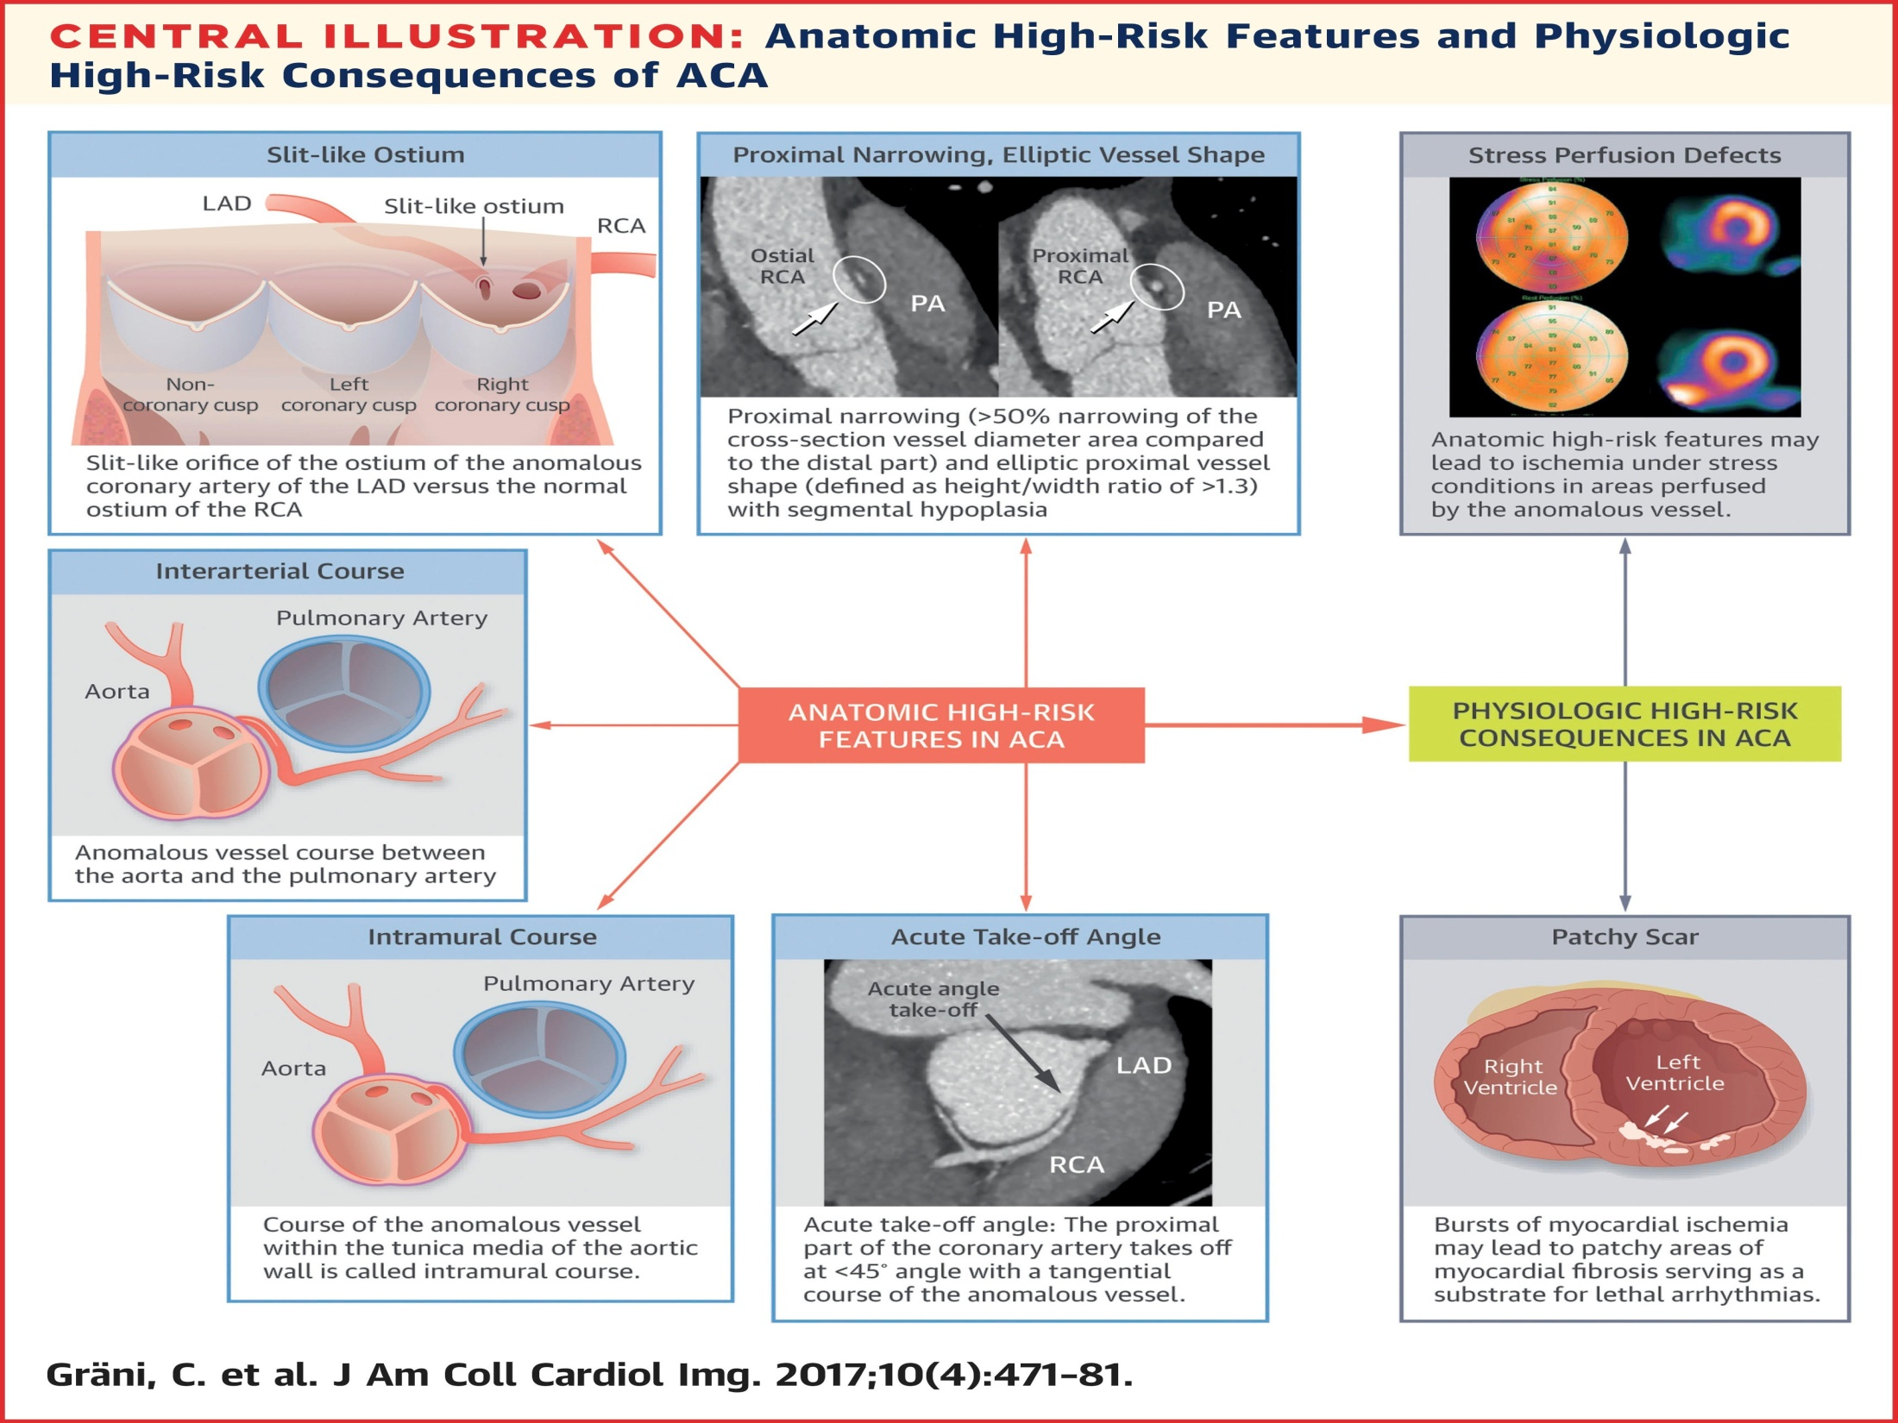

Slide 44
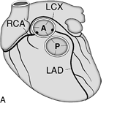
Left circumflex artery from right coronary artery/sinus:
  LCX passes behind aorta to reach its normal supply territory.
  No clinical significance; may be compressed if both aortic and mitral prosthetic fixation rings are implanted.
  Unusually higher incidence of atherosclerosis.
LAD from right coronary artery/sinus:
  Rare in absence of congenital heart disease.
  Common in TOF.
  Passes in front of RVOT or through IVS.
  Rarely passes in between aorta and RVOT.

Slide 45
Right coronary originating from the left coronary sinus
RCA originating from the left coronary sinus or as a branch of a single coronary artery is found in 0.03% to 0.17%
The Proximal pathway of RCA – usually interarterial, and can be associated with SCD in up to 30%.
Both right and left ACAOS have significant clinical consequence if the ectopic artery has an interarterial course or intramural intussusception
A constant relationship is observed between left ACAOS and sudden death or ischemia during extreme exercise .

Slide 46
Possible Paths Of Connection To Opposite Cusps
  Retrocardiac
  Retroaortic
  Interarterial, between aorta and PA
  Transseptal(supracristal).
  Prepulmonic

Slide 47
Pre-pulmonic: usually no hemodynamic consequences(rarly mild angina). This anomaly usually involves the LMCA and particularly common in TOF.
Retro-aortic: Posterior to the aortic root.
No hemodynamically significane, but may complicate valve surgery.
This anomaly usually involves an artery arising from RCA or right sinus of Valsalva that supplies the distribution of LMCA or LCX artery.

Slide 48
Inter-arterial:
Between the aorta and pulmonary artery, associated with more severe prognosis and increased risk of SCD esp on Exertion.
One hypothesis - Exercise leads to expansion of the aortic root and pulmonary trunk and this may increase the existing angulation of the coronary artery, decreasing the luminal diameter.
Another hypothesis - Vessel has an aberrant course within the aortic wall and is often hypoplastic and exposed to a lateral compression over the entire proximal intramural tract (intussusception into the aortic wall).
However, in these patients, resting electrocardiograms are usually normal and stress tests are not always positive for inducible ischaemia

Slide 49
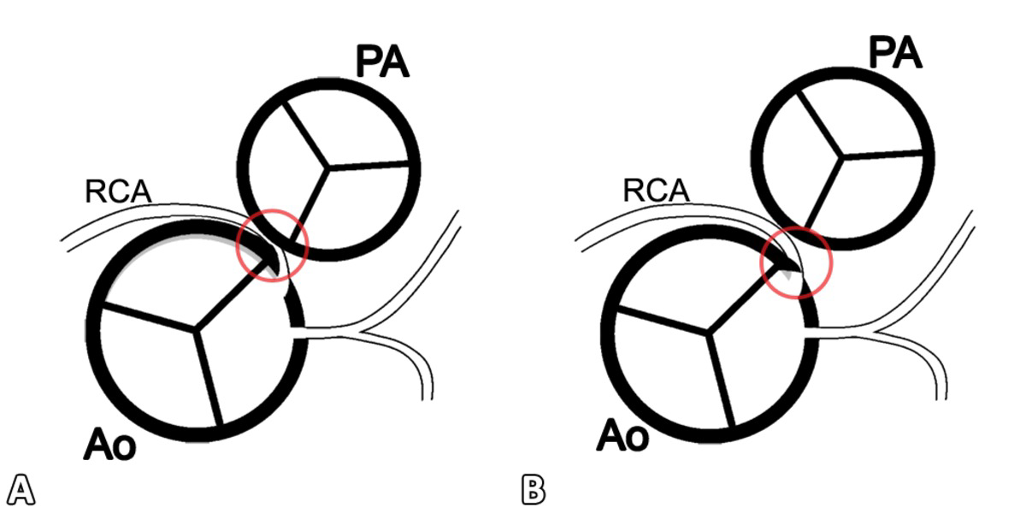
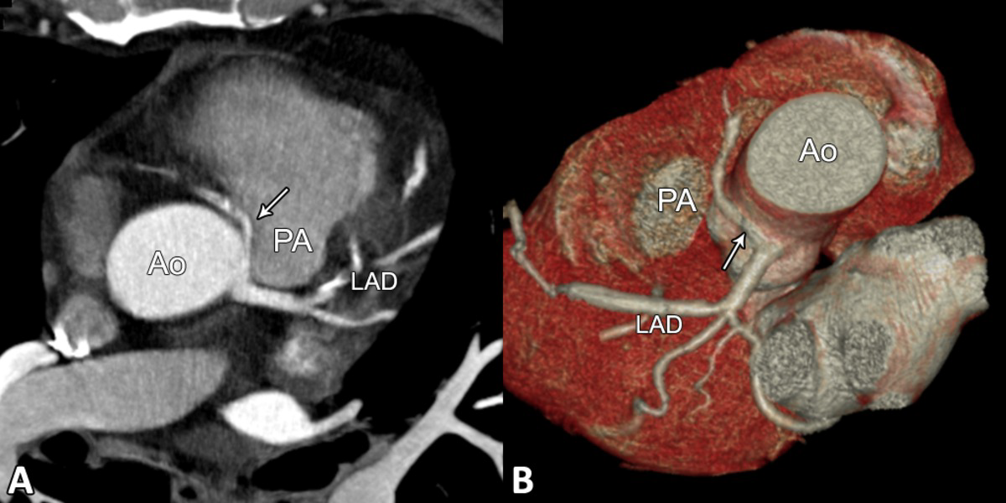

Slide 50
Trans-septal:
This refers to a coronary artery taking a subpulmonic course.
The artery traverses anteriorly and inferiorly through the interventricular septum and takes an intramyocardial course, giving off septal branches and finally emerging at its normal epicardial position.
The arteries most commonly involved are the LAD or LMCA.

Slide 51
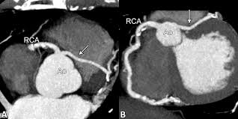
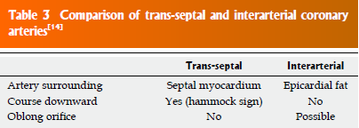

Slide 52
Retro-cardiac:
In this case the path is behind mitral and tricuspid valves, in the posterior AV groove.
The clinical relevance of this coronary anomaly may be due to underlying coronary atherosclerosis

Slide 53
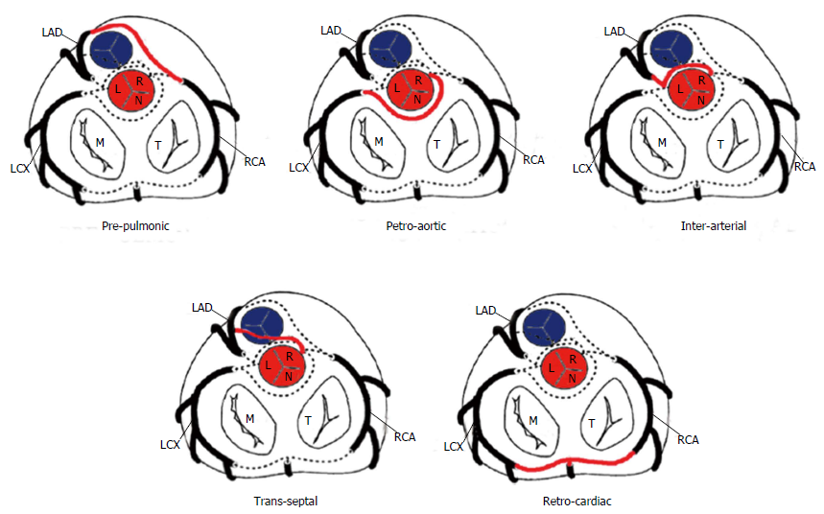

Slide 54
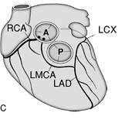
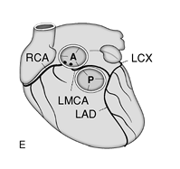
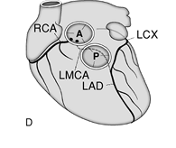

Slide 55
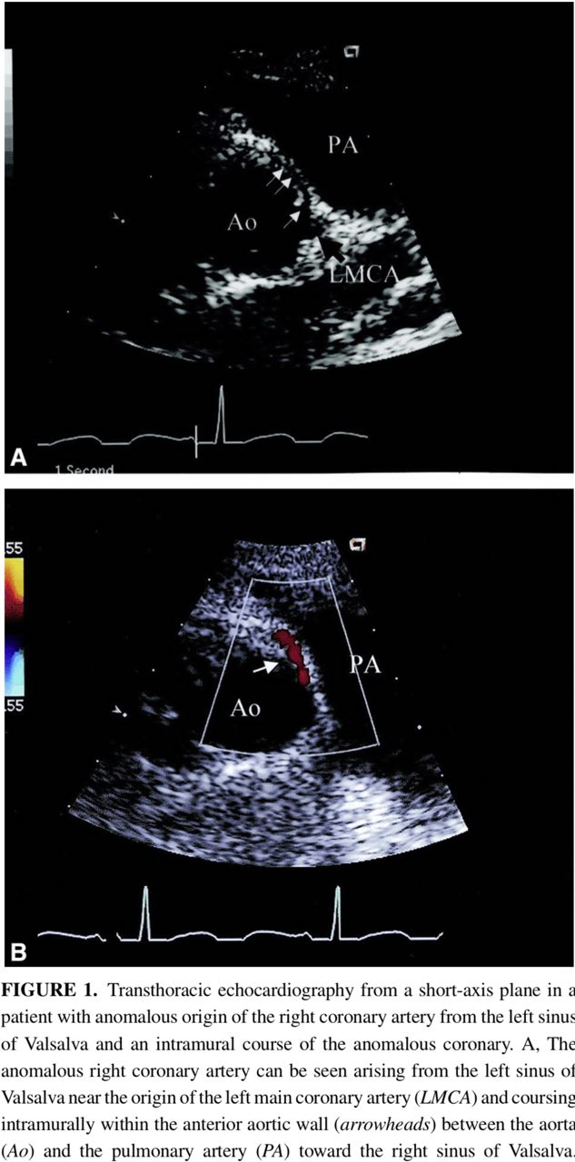
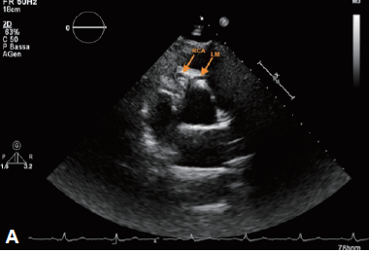
Modified parasternal short axis demonstrating RCA origin from the RCC and LM origin
from the RCA.

Slide 56
ANGIOGRAPHIC APPEARANCE

Slide 57
L C X
Often encountered after cannulation of the LMCA when a true LCx is not apparent, raising suspicion that it may be anomalous.
When one encounters ‘absence’ of the LCx
(1) separate LCx from the LCS
(2) LCx arising from the RCA or from the RCS originating near the RCA ostium.
Notes:
as the LAD opening is usually higher than the LCx opening. Traditional left angiographic views can then be performed for both arteries with separate catheters

Slide 58
In the latter situation, the course is usually retroaortic and it can usually be cannulated with the Judkins right catheter or right Amplatz. A multipurpose catheter is useful when the coronary artery origin is low and has a sharp inferior course; after engaging the ostium of the RCA, a clockwise rotation will engage LCX
It wil be visualised coursing to the left upon injection of the right coronary ostium, and it will be seen as a ‘dot’ posterior to the aorta on RAO projections.

Slide 59
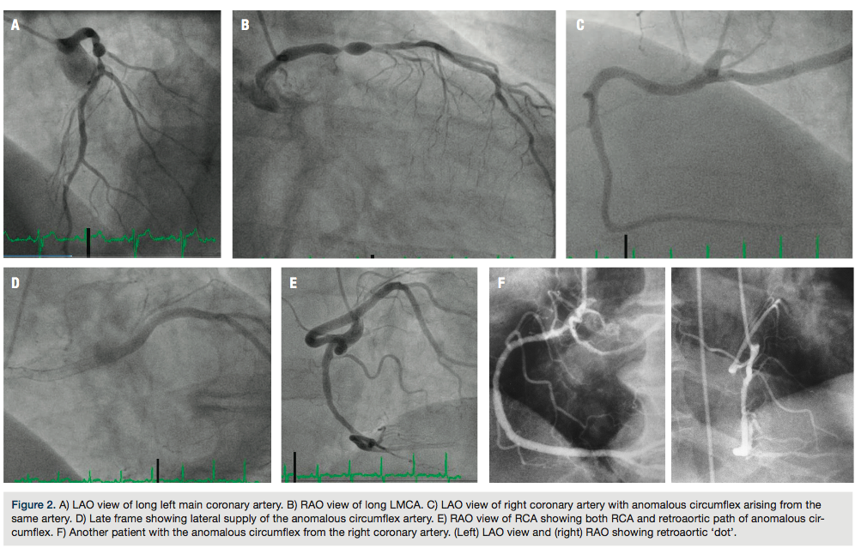

Slide 60
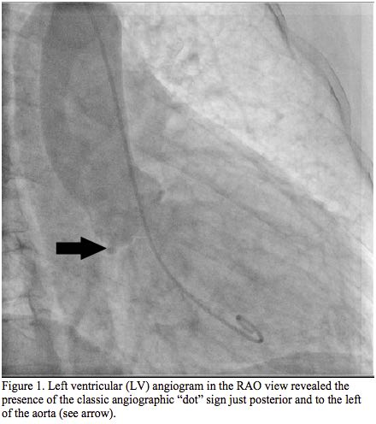
Visualization of the “dot” sign on the left ventricular (LV) angiogram in the RAO view (just posterior and to the left of the posterior aortic margin) is an easy clue to the identification of an anomalously arising circumflex artery with a retroaortic course.

Slide 61
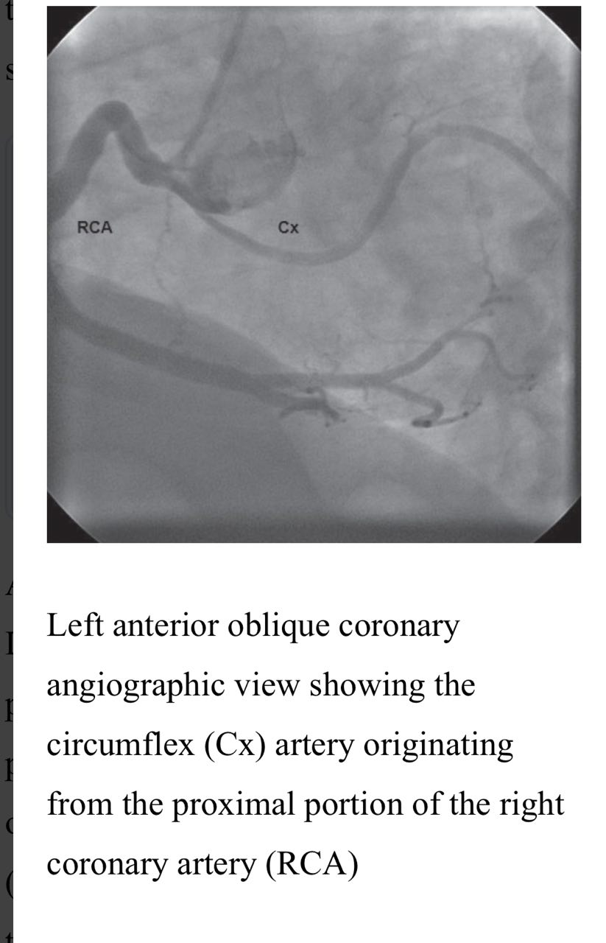

Slide 62
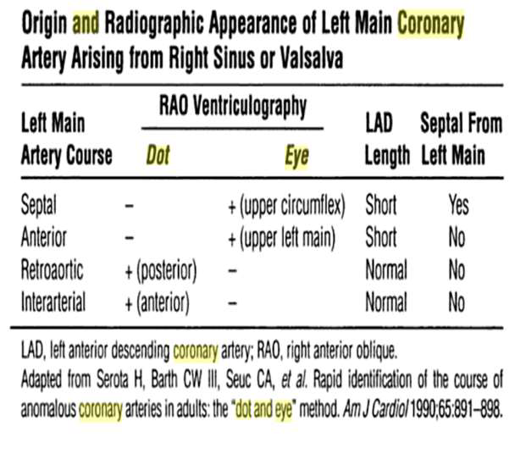
LMCA

Slide 63
Septal ALMCA
Runs an intramuscular course through the septum a, traveling upward in the mid-septum, then branching into the LAD & LCX.
Hence, the LAD artery is relatively short and the initial portion of the circumflex artery courses toward the aorta.
Septal perforating arteries – Helps to identify anomaly.

Slide 64
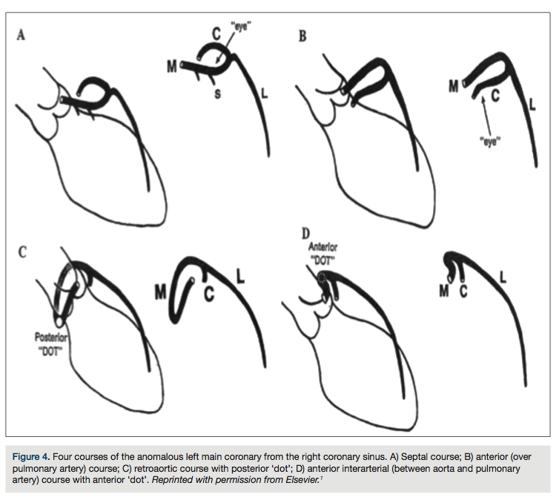

Slide 65
The Anterior ALMCA crosses the anterior free wall of the right ventricle over the pulmonary artery & divides at the mid-septum into the LAD and LCX.
The Retroaortic ALMCA passes posteriorly around the aortic root, dividing into the LAD and LCX of normal length and course.
The Interarterial ALMCA courses between the aorta and pulmonary artery, dividing into the LAD & LCX of normal length and course

Slide 66
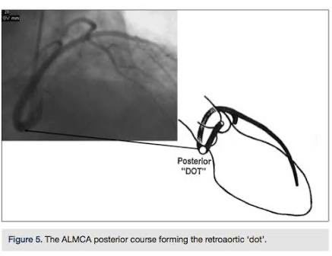
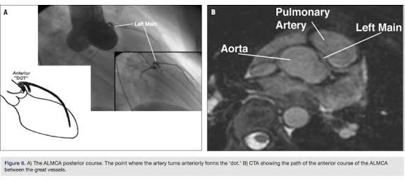

Slide 67
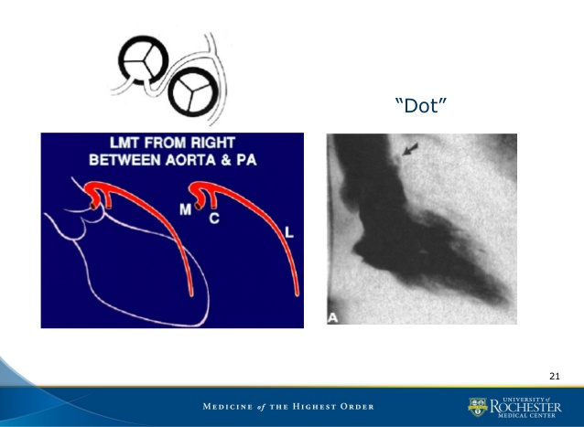
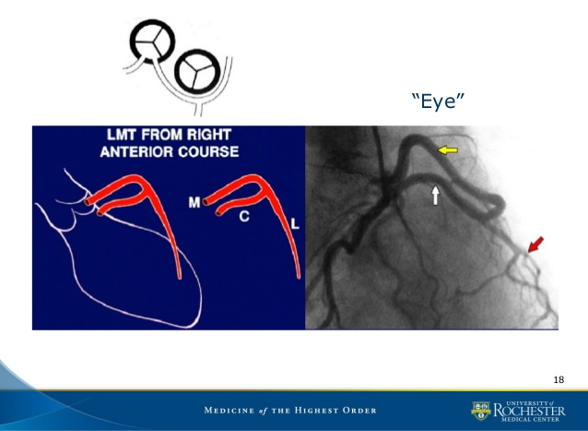
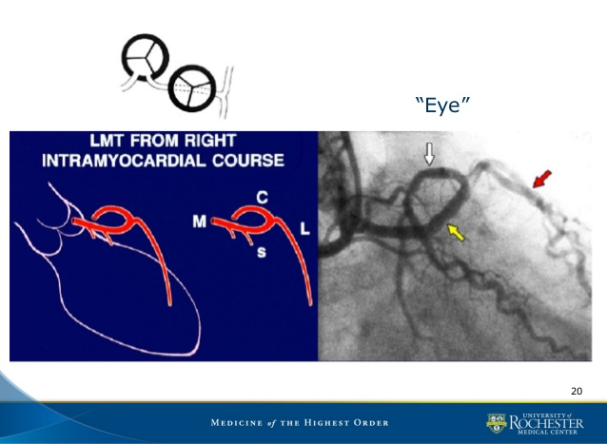

Slide 68
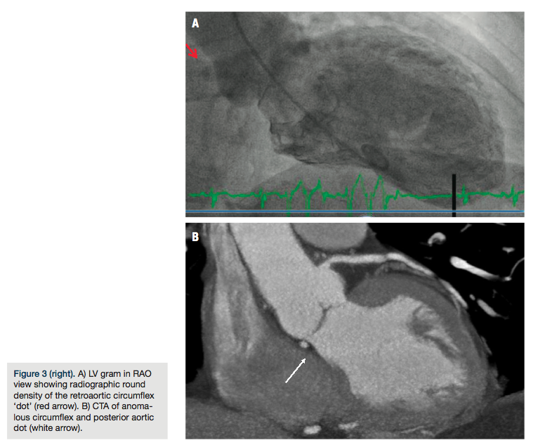

Slide 69
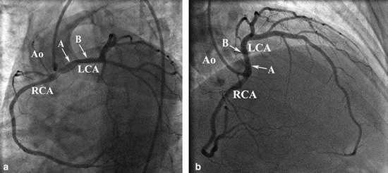
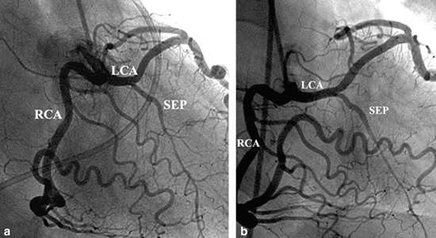
INTRAMURAL
INTRA SEPTAL

Slide 70
ANOMALOUS ORIGIN OF THE RCA FROM THE LEFT CORONARY SINUS OR FROM THE AORTA ABOVE THE CORONARY SINUSES
During RAO ventriculography , ARCA is seen “on end,” anterior to the aorta, and appears as a radio-opaque dot.
It diagnosed when it is opacified while injecting the LMCA. In these circumstances, the ostium lies in close proximity to the LMCA ostium, and there is sufficient reflux of contrast to opacify the aberrant RCA.

Slide 71
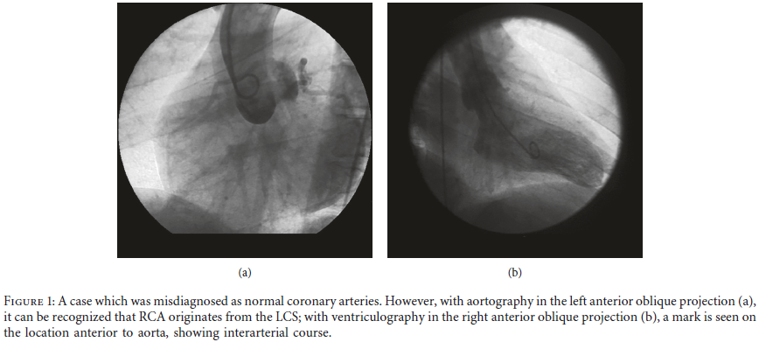

Slide 72
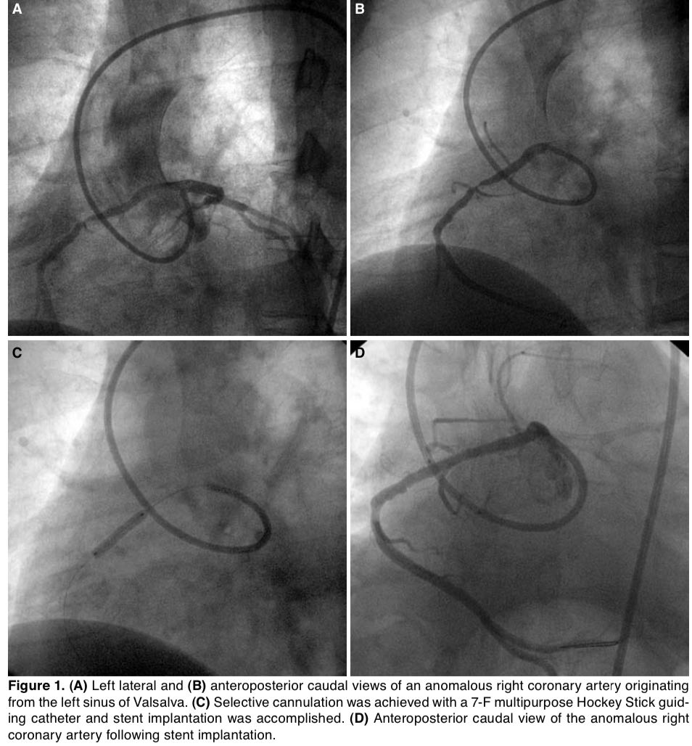

Slide 73
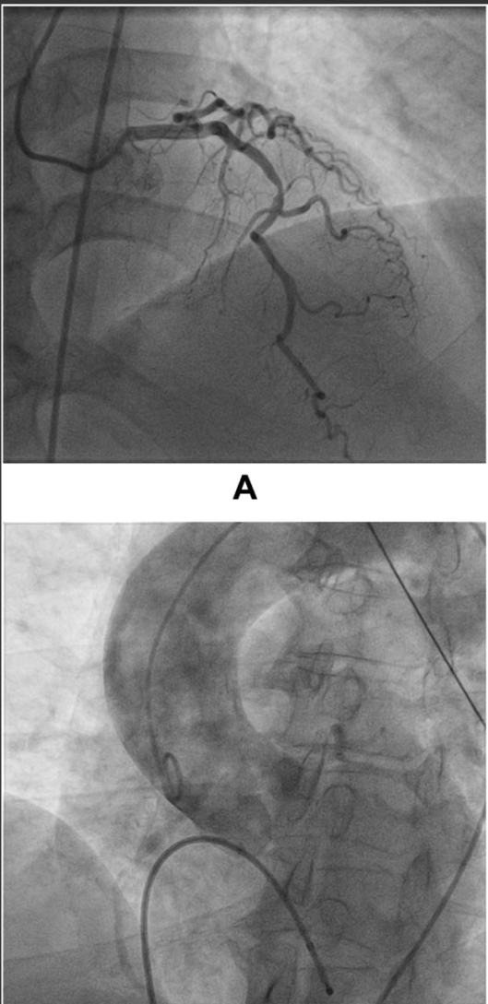
RCA FROM POST WALL OF AORTA

Slide 74
Manifestations of ACAOS
SCD: associated with extreme exercise in young adults
  Low cardiac output and bradycardia or asystole typically occur early after extreme exercise.
  Terminal ventricular fibrillation may also occur.
Dyspnea, palpitations, angina pectoris, dizziness and syncope:
  More frequently seen in older adults (specifically women)
  Related to the onset of hypertension.

Slide 75
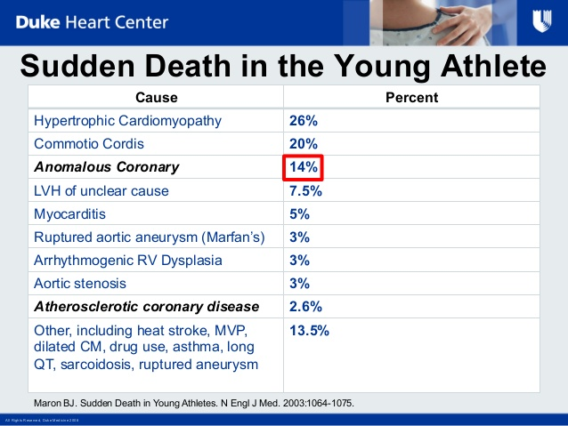

Slide 76
MANAGEMENT
Medical treatment/observation
  Beta blockers
  Restriction of activity
Coronary angioplasty with stent deployment of the intramural segment
  Justifiable in the presence of
  (1) disabling symptoms and/or a high risk of sudden death
  (2) area stenosis more severe than 50% on IVUS
  (3) a large dependent myocardial territory (> 1/3rd of total)
  (4) reversible ischemia, as documented by a nuclear stress test.
Surgical repair
  Recommended for left-ACAOS that involves a large territory at risk.
  Direct reimplantation, unroofing of intramural coronary segment, osteoplasty

Slide 77
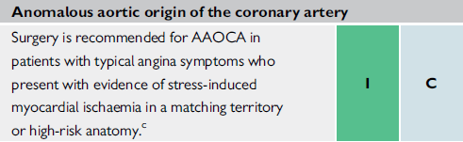

High-risk anatomy - Intramural or interarterial course and orifice anomalies (slit-like orifice, acute-angle take-off, orifice >1 cm above the sinotubular junction).
ESC 2020
Notes:
AAOCA = anomalous aortic origin of a coronary artery; AAOLCA = anomalous aortic origin of the left coronary artery; AAORCA = anomalous aortic origin of the right coronary artery;

Slide 78
SINGLE CORONARY
A single aortic ostium or origination provides for all of the coronary blood flow with no other coronary artery from an ectopic site.
Incidence 0.024%.
40% associated with cardiac malformations; TOF, TGA, truncus, BAV.

Slide 79



Slide 80
Coronary blood flow is not affected unless congenital or acquired obstructive disease is present in the proximal trunk.
Incidence of atherosclerotic disease not increased in the mixed trunk.
An ectopic single coronary ostium more susceptible to congenital or acquired obstructive disease.
Coronary angioplasty of the common trunk contraindicated.
CABG: arterial grafts preferred
  Provide long lasting conduits.

Slide 81



Slide 82

Notes:
NORMAL VESSEL – MI DUE TO KINKING

Slide 83

A: Supravalvular aortogram in left anterior oblique projection illustrating a single origin of the coronary arteries originating from the right sinus of Valsalva (Lipton R-IIA); B: Selective coronary angiography frame in left anterior oblique view showing a single coronary artery from the right sinus of Valsalva. Cx: Circumflex artery; LAD: Left anterior descending; RCA: Right coronary artery.

Slide 84

Ectopic Coronary Ostium in NCS
Benign anomaly
Most commonly involves LCA ostium
Difficult cannulation- unexpected location,tangential or slitlike nature
Nonselective angiography-longer than usual LMCA
RAO and straight lateral projections are most useful
For selective catheterization Amplatz or Multipurpose curved catheters offer best chance of success

Slide 85

Ectopic Coronary Ostium Arising Outside the Aortic Root(Ascending Aorta)
Usually involves anterior/left surface of aorta
Frequently have slit like orifices and tangential proximal course along aortic wall
RCA is most frequent ectopic artery.
Predisposed to more atherosclerosis.
Association with Congenital aortic valve anomalies

Slide 86
ANOMALIES OF INTRINSIC CORONARY ARTERIAL ANATOMY

Slide 87
CONGENITAL OSTIAL STENOSIS OR ATRESIA
Atresia (dimple seen from aortic side)
Stenosis due to membrane or fibrotic ridge.
Frequently occurs in pulmonary valve atresia with intact ventricular septum.
Collateral circulation established prenatally.
During myocardial stress testing, dependent myocardial territory may show reversible ischemia– collateral circulation inadequate for maximal myocardial demand.

Slide 88
Other features - Ostial dimple
Blind distal left main trunk
In COSA, the presence of only 1 or 2 full-diameter connecting collateral vessels, without narrowing at the transition between the providing and the receiving vessel.
In addition, such acquired collateral vessels enlarge progressively after birth, and they are typically smaller than the distal recipient vessels; this “step-up phenomenon” is typically observed only in postnatally acquired collateral vessels.

Slide 89


Slide 90

Coronary ectasia or aneurysm
Defined as localized dilations in an otherwise normal sized coronary artery.
Morphologically defined as an increase in diameter of a coronary segment by >50% with respect to normal.
Congenital or acquired(atherosclerosis, Kawasaki disease).
Primary and secondary ectasia
Primary:
  Localized segment has a disproportionately larger diameter in comparison to neighbouring segments
  Localized decrease in flow velocity.
Secondary:
  Global coronary dilation secondary to increased or fistulous flow.
  Increase in flow velocity.

Slide 91
INTRAMYOCARDIAL CORONARY ARTERY (MUSCULAR BRIDGE)
Defined as a segment of variable length covered by myocardial fibres but that otherwise lies subepicardially.
Reported prevalence 1.7% by angiographic studies (only in LAD).
  25% mean prevalence by pathologic studies, LAD most common.
  Length of bridges varies from 4 mm to 40 mm
Angiographically - Systolic narrowing of a coronary artery segment, facilitated by intracoronary administration of NTG.
Unlikely to cause absolute flow reduction- 85% of human coronary flow occurs in diastole.
Usually clinically silent; rarely the longer and deeper bridges manifest with myocardial ischemia, ACS or SCD.

Slide 92

Atherosclerosis in Myocardial bridge
IVUS in 69 patients with myocardial bridge found increased incidence of atherosclerosis at segments proximal to the bridge, but no plague within or distal to the bridges.
Ge J, Jeremias A, Rupp A, et al. New signs characteristic of myocardial bridging demonstrated by intracoronary ultrasound and Doppler. Eur Heart J 1999;20:1707-16

Slide 93
ANGIOGRAPHIC SIGNS
Straight course
Lack of spring – like motion
Systolic compression
Proximal & distal angulation

Slide 95


Slide 96
DUPLICATION
Split RCA
Defined as an RCA that features a split PDA with the anterior subdivision of the RCA leading to the distal portion of the PDA supply anterior free wall of the RV.
The other (posterior) bifurcation of the RCA maintains a course in the atrioventricular groove and forms the uppermost portion of the posterior descending branch.
Duplication of LAD
Often one of the duplicated LAD arteries may arise from the RCA and take a prepulmonic, septal or inter-arterial course.
Its not intrinsically haemodynamically significant, but it complicate CABG

Slide 97




Slide 98
ANGIOGRAPHIC SUBTYPES
Type I: The short LAD runs in the AIVS and is generally the source of all major proximal septal perforators. The long LAD also runs in the AIVS, descending on the left ventricular side of the AIVS, reentering the distal AIVS to reach the apex.
Type II: The short LAD is the same as in type 1, but the long LAD descends over the right ventricular side before reentering the AIVS.
Type III: The short LAD is consistent with that in types 1 and 2. The long LAD travels intramyocardially in the ventricular septum.
Type IV: The short LAD originates from the LMCA. The major septal perforators and the diagonal branches originate from this vessel. The long LAD arises from the RCA. It is extremely rare among the four types.

Slide 99



Slide 100
ANOMALIES OF TERMINATION

Slide 101
Coronary Arteriovenous Fistula
A direct communication between a coronary artery and the lumen of any one of the four cardiac chambers, the coronary sinus or its tributary veins, or the superior vena cava, pulmonary artery or pulmonary veins close to the heart.
First described by Krause in 1865.
Coronary artery site-
  RCA or its branches- 50-55%
  Left coronary artery 35%
  Both coronary arteries 5%
Fistula occurs either in the main vessel that continues beyond the fistula (a side-to-side pattern) or at the termination of the main vessel itself or at a branch (an end artery).

Slide 102
Coronary artery proximal to the fistula is always dilated, elongated and serpiginous,
Artery beyond the fistula abruptly reduces in diameter.
Site of Fistulous Connection
  > 90% of fistulae open into right heart chambers or their connecting vessels.
  True AV fistulae to the veins themselves (coronary sinus or its major branches or venae cavae) are uncommon
  40% connect to RV, 25% to RA, 15%-20% to pulmonary artery, 7% to coronary sinus and only 1% to SVC.
  8% of fistulae drain into left heart chambers or their tributaries, usually LA, less often LV(about 3%), and rarely the proximal pulmonary veins.

Slide 103
Fistulae entering the right side of the circulation
  Rapid systolic and diastolic runoff from the aorta.
  L- R shunt, qp/qs is seldom larger than 1.8.
Left heart fistulae
  Runoff from the aorta during both systole and diastole when fistulae enter LA or only during diastole when they enter LV.
  No L-Rshunt.

Slide 104
Clinical features
Most patients present late in life, occasionally in childhood and rarely in infancy.
Most patients asymptomatic; present incidentally with continuous murmur.
80% of patients < 20 years are asymptomatic, only 40% of those older are asymptomatic.
Most common symptoms are effort dyspnea and fatigue.
Heart failure occurs in 12% to 15% of patients presenting for surgery.
  Heart failure more common in older patients , fistulous connection to the coronary sinus & RA.

Slide 105
Natural history
Small fistulae remain small, and moderate fistulae slowly increase in size.
Onset of dyspnea, heart failure and angina can occur in young patients with large fistulae.
As shunt is usually moderate, symptoms often do not appear until later in life consequent to long-standing moderate lv volume overload.
Maximum prevalence of heart failure occurs in the fifth and sixth decades.
Complications - IE, aneurysm, spontaneous rupture
Spontaneous closure recorded; very rare.

Slide 106
Diagnosis
Clinical Examination:
Diagnosis is often strongly suspected from physical signs
  Continuous murmur that is maximal to the right of the sternum when the fistula enters RA
  Lower left sternal edge when it enters RV/LV.
  Murmur may be only diastolic when it enters LV.
  Left infraclavicular area when it enters PA.
Systolic thrill is occasionally palpable when the fistula lies anteriorly (entry into RA/RV).
Large shunts- wide pulse pressure and jerky pulse.

Slide 107
ECG:
Normal > 50% cases; RV/LV overload in remainder.
CXR:
May be normal or show mild CM with plethora.
ECHO:
Can detect importantly enlarged coronary arteries and may also confirm specific chamber enlargement.
Cardiac Catheterization: Aortography and selective coronary angiography
Gold standard
Calculate L-R shunts and Right heart pressures.
CTA:
Diagnostic procedure of choice in cases that will not require hemodynamic measurements to make management decisions.

Slide 108


Slide 109
MANAGEMENT
Indications for surgery:
Recommended that diagnosis of a coronary AV fistula is an indication for operation unless the shunt is small (Q p/Q s < 1.3).
  At least some of these fistulae will increase in size and eventually produce symptoms and heart failure
  Tendency for development of IE
  Low probability of spontaneous closure
  The safety and efficacy of operation.

Slide 110
Surgical options:- External ligation or intracardiac closure on CPB.
Percutaneous occlusion:- Detachable balloons, coils, vascular plugs, PDA/ASD/VSD devices.
  Ensure no coronary supply to myocardium distal to point of occlusion.
  Proximal coronary artery persistently dilated- prone to thrombotic occlusion- long term antiplatelet therapy advisable and anticoagulation proposed in patients with moderate persistent aneurysmal dilation.

Slide 112
SYSTEMIC TERMINATION
In this CAA the coronary artery terminates into a systemic artery.
This CAA should be differentiated from fistulae - the coronary artery is not enlarged and tortuous.
Systemic termination of a coronary artery is an uncommon finding, but some authors have suggested that the prevalence can be underestimated.
In the absence of a pressure gradient, such as that due to a stenosis, a coronary-systemic arterial communication is unlikely to be significant.

Slide 113
Anomalous collateral coronary arteries
Congenital anomalous collaterals- > 1 mm anastamotic communications between adjacent unobstructed coronary arteries or branches.
Prognostic implications: protective in the event of occlusion of one of the connected vessel.

Slide 114
Coronary Artery Patterns with Congenital Heart Defects

Slide 115
TOF
40%- long, large conus artery may arise from a separate ostium.
4-5%- LAD from RCA
  Passes across RVOT
  Makes transannular incision difficult at surgery.
Occasionally, single coronary from either right or left sinus
  May pass across RVOT or behind the aorta.

Slide 116

D - TGA
Important to identify anomalies prior to arterial switch
    Some patterns difficult to transfer with arterial switch.
Sinuses facing RVOT – Facing sinuses.
Nomenclature of facing sinuses depends on relation of great vessels.
  Side by side relationship- anterior or posterior.
  Oblique relationship- left anterior or right posterior.
  Anterior-posterior relationship- right or left.

Slide 117

L - TGA
Aorta is anterior and to left of PA
Coronary arteries come from facing sinuses
Anterior sinus is usually noncoronary sinus
Morphologic right and left coronaries are concordant with morphologic right and left ventricle.
LCA
  Supplies LV, arises from right facing sinus.
RCA
  Supplies RV, arises from left facing sinus.
Most common variant- single coronary from right facing sinus.

Slide 118


Truncus arteriosus
Depends on the no of cusps in truncal valve.
Tricuspid- RCA from right anterior sinus, LCA from posterior sinus
Bicuspid
  Anterior/ posterior- LCA from posterior sinus and RCA from anterior sinus.
  Right/ left- LCA from left and RCA from right sinus.
Quadricuspid
  2 anterior and 2 posterior cusps
  LCA from left posterior cusp and RCA from left or right anterior cusp
High origins of right and left coronaries frequent.

Slide 119

BICUSPID AORTIC VALVE
Associated with left coronary dominance.
High incidence of immediate bifurcation of LCA into LAD and LCX.

Slide 120
CORONARY ARTERY DISEASE AS A RESULT OF CONGENITAL HEART DISEASE

Slide 121
Coarctation of aorta
  Intimal proliferation and medial thickening due to hypertension.
  Risk of premature atherosclerosis.
Supravalvular AS
  Ostial obstruction –aortic medial proliferation or adherence of aortic cusp.
  Thick walled, tortuous coronaries – prematurely atherosclerotic.
Aortic regurgitation
  Large smooth walled coronaries
Coronary artery ectasia
  Elongated, tortuous dilated coronaries in adults with .
Pulmonary atresia with intact ventricular septum
  Development of ventriculocoronary connections.

Slide 122


Slide 123
CONCLUSION
Coronary anomaly common, but rarely causes symptoms.
Most of them detected during angiography and will have difficulty in cannulation.
Atypical chest pain or TMT positive in athletes needs attention and evaluation.
It can cause SCD.

